Slide 1
Session One Data Skills for Empirical Research, Kellogg Research Support
Summer, 2022
Notes:
Welcome. We are so happy you’re here.
What you are about to hear next is about the closest you will get to a lecture in this workshop series. Most of the rest of this will be pretty interactive.
There will be discussions and you follow along with a demonstration, and maybe try to solve a few problems yourself.
But before we get into demonstrations of tools and how to apply them to your research work, I want to talk a bit about the reproducibility of that work you are about to start.
It is a very important topic, and I believe there are a few general principles that, if kept in mind, can help you quite a lot when you go to reproduce your work in the future.

Slide 2
Goals for This Session
Learn Principles for Replicability
Get Acquainted w/ Kellogg Linux Cluster
Practice Using git & Jupyter Notebook
Notes:
And so, with that…. I will give you a little preview of what to expect in the next 6 ½ hours we will be together.
In a few moments I will hand it over to my colleague Ambreen, who will lead you through the fundamentals of working on KLC, including working with git and Jupyter notebooks on KLC.
This is to make sure you are familiar with these things that we will do repeatedly in future weeks. We assume no prior knowledge of any of those things.
Then the next 3 weeks will be deep dives into some powerful tools that we think all of you are probably going to use at one time or another.
Then the final 3 weeks put the pieces together to help you with some very complicated – and very common – applied problems:
Checking and cleaning your data, writing bulletproof code, and a final session on how to make your jobs run faster.

Slide 3
Who Cares About Replicating Results?
Journals
Referees
Readers
Your co-authors
Your RAs
… and your future self!
Notes:
You should care about reproducibility because it matters to so many different people.
<CLICK>
When you publish your work, you will need many other stakeholders to be able to reproduce your results. It will be a problem for you when they cannot.
<CLICK>
Speaking of headaches, your collaborators will thank you – or curse you – depending on how easy or difficult it is to follow what you have done and replicate results consistently.
Even if you do not expect to work with others or do not value their feelings, there is one very important collaborator you will always have:
<CLICK>
Your future self. That person will always be responsible for everything your younger self does. Be kind to the future version of you.

Slide 4
Why Are Papers So Hard To Replicate?
Reproduction is difficult because collaboration is difficult.
Did somebody on the research team…
… correctly interpret and implement your inclusion criteria?
… make other adjustments to the raw data?
… include the results from the correct model specification in the paper?
… rely on a program or data that you no longer have access to?
... accidentally overwrite a file?
... intentionally overwrite a file?
... quit and leave you up the creek without a paddle?
Notes:
There are many ways your quantitative research could become difficult to reproduce.
<CLICK>
For one thing, you will probably try many different model specifications, sampling schemes, and data cleaning techniques as you create different drafts of your paper.
You need some way to keep the versions of your data, your code, and your paper in sync.
<CLICK>
You might also have a very long time interval between when you do your work here and when your manuscript is published. A few years or even longer.
What if you can’t rerun your code on the computer it was on? Or if some of the software functions you called have been deprecated?
<CLICK>
What about all the files you used? Have they been backed up? Are you sure the files in your backups are exactly the same as the ones you originally used?
<CLICK>
Or does some aspect of your work rely on a collaborator to do something that you don’t know how to repeat for yourself in the future?

Slide 5

Will You Collaborate Well With Yourself?
What would you need to replicate calculations right now from a problem set you did as an undergrad 4 years ago?
10 years from now, will you be able to recreate the tables from a published paper, which went through many stages of revision?
What will you do with all your programs and data when you leave Northwestern?
Notes:
Just ponder these situations…
What would it take for you to reproduce some non-trivial piece of work you did 4 years ago?
Well, I bet it will take something similar for your future self to be able to reproduce your work today, 4 years from now.
One day, you will all move on from Northwestern. That should get you thinking: What will I need to do with all my files and notes when I go somewhere else?

Slide 6
Setting Your Future Self Up For Success
1. Automate Whenever Possible
2. Keep Good Records
3. Test, Test, Test!
Notes:
Fortunately for you, this is a management, and we have some commonsense ideas for how to make collaborations – including with your future self – work better.
Some of those concepts that are most relevant to your scientific computing projects include:
Keeping records of what you do that will be easy to use,
Being very economical with your solutions. The #1 easiest way to fail at replicating your results is to present yourself with 2 different ways to solve the same problem.
And recognize that humans make mistakes. We forget things. We sometimes make poor decisions. So more generally, give your future self fewer opportunities to make mistakes.

Slide 7
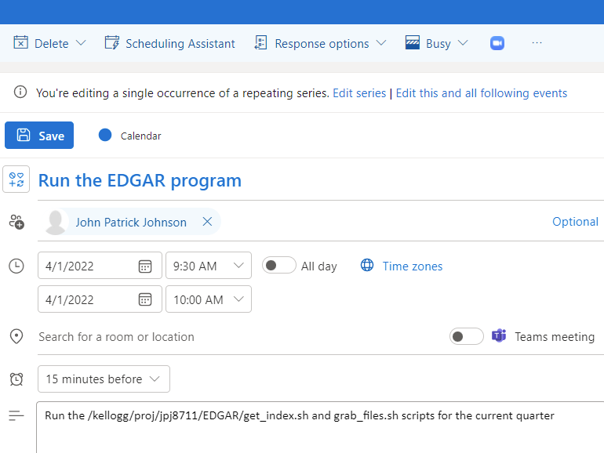
Automate To Reduce Human Errors
Do you use your calendar to do things like maintain your source data?
What could go wrong?
Notes:
Who here has tasks that you manage this way, by placing a reminder on the calendar to do something?
<Pause for discussion>
We all do, as evidenced by this recurring event that actually lives on our calendars.
But whenever possible, you should take situations like this as a challenge:
Is there a way to write a program that would do this action for me – and ideally write an entry in a log to show when it was done?

Slide 8
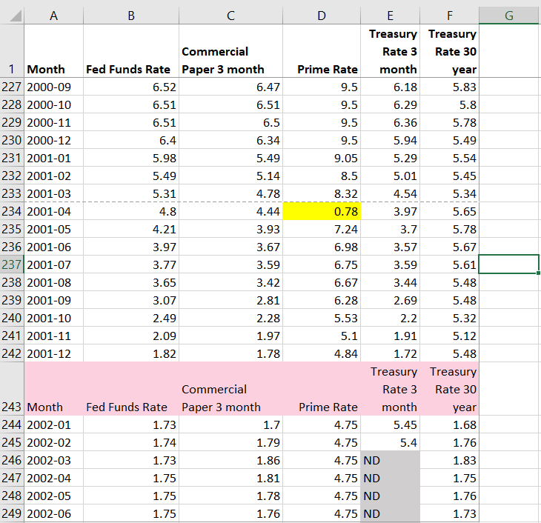
Automate Reduces Human Errors
You need to fix this flawed source data:
* Delete extra
* Move the decimal place in one cell
* Set ND to missing values
header rows
Why not just fix these issues in Excel?
Notes:
Here is one last cautionary example about manual work.
This is real source file with historical information about different interest rates, and it is a messy file.
Highlighted in yellow is a cell that contains a clerical error. The prime rate in April, 2001, should be 7.8 -- not 0.78
The file also has some inconvenient flaws. The header row keeps repeating throughout the data, what you see highlighted in pink.
Also, the source file uses “ND” to indicate null. You probably would want those values in the CSV file to be blank before reading these into Stata.
<CLICK>
So the dilemma is, you could fix these issues in a few seconds in Excel.
Just overwrite cell D234. Manually delete the extra headers. Do a global search and replace on “ND.”
But should you?
If your future self had to recreate your analysis from scratch in the year 2025, would you remember to do all those things exactly as you had before?

Slide 9
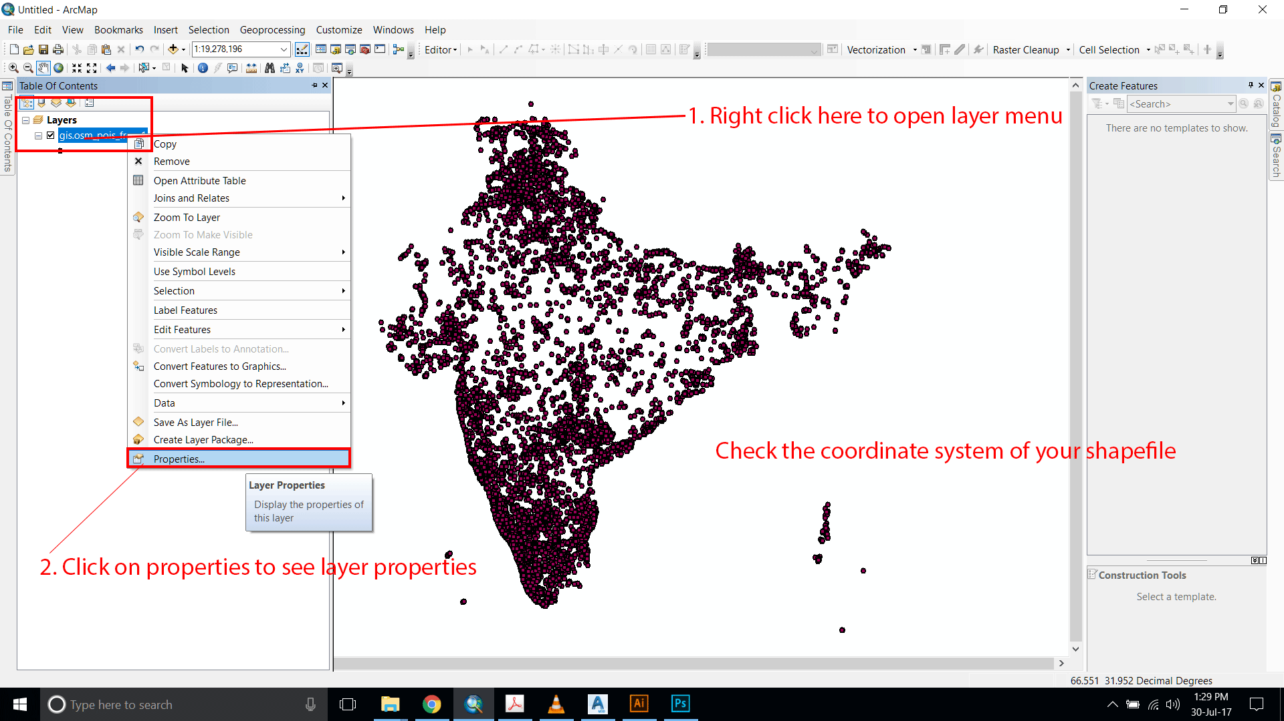
Automate To Reduce Human Errors
Will your future self be able to do this?
Notes:
Along the same lines, you want to be mindful of work you are doing by clicking your mouse.
Again, this is something we all do. In fact, what you see in front of you came from an actual ArcGIS tutorial we helped to organize a few years ago.
Some tools, like ArcGIS, certainly make it easy for you to perform complex actions with a sequence of intuitive mouse clicks.
But should you?
If you had to recreate this geospatial project from scratch 4 years from now, would you possibly forget the exact sequence of menu clicks you did?
Or maybe, the menus might be very different in a future version of the software?
If there were a way to script these actions – and leave a record behind of what actions were taken – that seems much kinder to your future self.

Slide 10
Organize Directories
This is a real directory with code & data that monitors load on KLC.
Is it clear where you would go to find load by user on a given date?
active_netids.txt
active_usernames.txt
daily_email.sh
email_lookup.py
emails_of_active_users.sh
loadavg.gnuplot
loadavg_history.klc01.txt
loadavg_history.klc02.txt
loadavg_history.klc03.txt
loadavg_history.klc04.txt
loadavg_history.klc05.txt
loadavg.png
monitor_load.sh
netids_of_active_users.sh
renice/
users_history.klc01.txt
users_history.klc02.txt
users_history.klc03.txt
users_history.klc04.txt
users_history.klc05.txt
vmstat.gnuplot
vmstat_history.klc01.txt
vmstat_history.klc02.txt
vmstat_history.klc03.txt
vmstat_history.klc04.txt
vmstat_history.klc05.txt
vmstat.png
Notes:
Tell me, does this situation sound familiar to you? Let’s say you go to a directory containing a project that one of your colleagues spent a lot of time on.
You just want to find one piece of information, but what you see is confusing to you, and you spend a lot of time opening random files and hoping to get lucky.
This is an actual directory created by Research Support for a project to monitor and report the usage load on KLC.
Where would you go to find the data showing load by user last week?
<Opportunity for interaction… one of these “history” files?>
The answer is surprising to me. It is actually underneath the “renice” subdirectory.

Slide 11
Organize Directories (Good Records)
Suggestion: Use intuitive directory and file naming conventions.
renice/
README.txt
inputs/
outputs/
programs/
run_logs/
versions_old/
programs/
1_get_ps.py
2a_sum_users.py
2b_sum_load.py
3_make_graphs.py
4_send_email.py
RUN_ALL_PROGRAMS.sh
Notes:
Ah, but suppose when you go inside that “renice” directory, you see something like this!
There is a readme file to explain what you need to know, but I can infer a lot without reading it.
You have subdirectories that clearly separate inputs, outputs, and the programs that create those outputs. It looks like there is a place containing logs of every time the jobs have run.
And those programs are named in a “self documenting” way. I think I know what order the jobs need to be run in, and there appears to be a script that will run the whole sequence for me.

Slide 12
Document Your Code (Good Records)
Document Everything!
Suggestion: Only document what you are willing to revise.
Also, avoid having multiple “systems of record.”
Notes:
This should be obvious to everyone. You should always document your code, and more comments and read-me files is bound to make things easier for your future self. Right?
<pause for effect>
<CLICK>
Actually, NO! I maintain that less is more when it comes to documentation.
In any event, you ABSOLUTELY MUST maintain your documentation. So if you have got comments running throughout your code, that’s fine,
but you will need to update the comments each time you update the code. Otherwise, you run the risk of your code doing one thing and your comments saying another.
That is a sure fire recipe for confusion when you crack open your Python program for the first time in 24 months to figure out why the numbers are suddenly different.

Slide 13
Version Control (Good Records)
Your Programs
Manage versions of your code with tools like git
You will get to practice this in our workshops.
Open Source Packages
Tools like conda or virtualenv for Python, Packrate for R packages
You will get to practice using conda in our workshops.
Computing Environments
Tools like Docker and Singularity (for preserving a KLC/Quest environment)
Caution: All tools require human judgment to be used well.
Notes:
Throughout these workshops, we will expose you to tools that will help you maintain a version history of your assets.
You will get a healthy dose of github over the next 7 weeks. I am sure many of you have used it to download source code from others.
Some of you may have even shared some of your own work with the world this way.
We want you all to have practice using several aspects of Github, pulling from a repo, committing your changes back to it, and reverting to a prior version.
<CLICK>
In addition, you will be exposed to some other powerful version control tools.
Most notably, you will see a few instances of conda, which you can use to create a version history of your Python packages.
This will help address the challenge I mentioned earlier, of using software that may or may behave the same 4 years from now. (If it is still available then.)

Slide 14
Don’t Repeat Yourself
Abstraction
Build your programs from modular code blocks
(a.k.a. functions, procedures, macros, subroutines, etc.)
Produce consistent results across programs
Only one place needs documentation
Only one place you need to test, debug
Notes:
This “Don’t Repeat Yourself” principle has to do with that second issue: You are better off solving a programming problem once rather than twice.
This is most easily achieved by designing and writing your code to use and reuse modular pieces.
Depending on your programming language, these modular pieces might be called functions, procedures, macros, and so forth.
That might be intimidating to someone who is new to programming, but the concept is very simple:
If you ever find yourself writing the some chunk of program in two different places to do the same thing… stop, and find a way so you can just write it once and then call it twice.
If you write the same block of code in two places, you open up the chance for the two blocks to get out of sync with each other.
You will see these ideas in action in later weeks as we work with text and discuss data validation.

Slide 15
One Way People Repeat Themselves
use "/rawdata/2018/wages.dta, clear
keep if taxyear == 2018
generate lnwage = ln(wage)
Scatter lnwage tenure, title("ln(wages) versus Tenure, 2018")
regress lnwage educ gender tenure
regsave educ gender tenure using results,
table(OLS_stderr, order(regvars r2))
replace
use results, clear
outsheet using results_2018.txt, replace
Notes:
One last idea…
To reproduce results implies that you were able to produce them correctly in the first place.
So throughout the workshops, we will try to emphasize the virtue of breaking your problems into smaller pieces
And then testing them relentlessly to convince yourself they are doing what you expect them to do.
Near the end of the series, one of our hours will be dedicated to helping you make your code “bulletproof.”

Slide 16
Get It Right The First Time
Make sure what you replicate is correct!
Break big problems into discrete pieces
Don't repeat yourself (abstraction)
Test liberally
Notes:
One last idea…
To reproduce results implies that you were able to produce them correctly in the first place.
So throughout the workshops, we will try to emphasize the virtue of breaking your problems into smaller pieces
And then testing them relentlessly to convince yourself they are doing what you expect them to do.
Near the end of the series, one of our hours will be dedicated to helping you make your code “bulletproof.”

Slide 17
Goals for Each Workshop Session
#1 – The Basics
KLC, git, Jupyter notebooks
Run a program from command line
Reproducibility Principles
#4 – Automate
Shell scripts
Scheduling
Leaving audit trails
#2 – Data Integrity
Learn about regular expressions
Test data assumptions
Fix data programmatically
#5 – Keep Automating
LaTeX on KLC
Exporting results automatically
Testing consistency in papers
#3 – Code Testing
What could go wrong with code?
Abstraction
Unit testing
#6 – Version Control
Using git smartly
conda
Containers
Notes:
And so, with that…. I will give you a little preview of what to expect in the next 6 ½ hours we will be together.
In a few moments I will hand it over to my colleague Ambreen, who will lead you through the fundamentals of working on KLC, including working with git and Jupyter notebooks on KLC.
This is to make sure you are familiar with these things that we will do repeatedly in future weeks. We assume no prior knowledge of any of those things.
Then the next 3 weeks will be deep dives into some powerful tools that we think all of you are probably going to use at one time or another.
Then the final 3 weeks put the pieces together to help you with some very complicated – and very common – applied problems:
Checking and cleaning your data, writing bulletproof code, and a final session on how to make your jobs run faster.

Slide 18
Appendix – Text Editors on KLC
KLC/Quest has several text editors available for you to use. The links below provide the basic syntax for other text editors available to you:
Nano: From any terminal session on KLC, type:
nano <file_name>
https://www.redhat.com/sysadmin/getting-started-nano
Emacs: From any terminal session on KLC, type:
emacs <file_name>
https://www.redhat.com/sysadmin/beginners-guide-emacs
Vi: From any terminal session on KLC, type:
vi <file_name>
https://www.redhat.com/sysadmin/introduction-vi-editor
Gedit: From a terminal session with graphics enabled, type:
gedit <file_name>
https://www.lifewire.com/gedit-linux-command-unix-command-4097153
Notes:
One last idea…
To reproduce results implies that you were able to produce them correctly in the first place.
So throughout the workshops, we will try to emphasize the virtue of breaking your problems into smaller pieces
And then testing them relentlessly to convince yourself they are doing what you expect them to do.
Near the end of the series, one of our hours will be dedicated to helping you make your code “bulletproof.”

